Slide 2
Welcome!
Meet your instructor

Slide 3
Today’s Agenda
Review the Definition of Design Thinking
Contrast Design Thinking with Other Disciplines
Breakout Group Activity: Compare Two Solutions
Recapitulation

Slide 4
Review the Definition of Design Thinking

Slide 5
Definition of Design Thinking
What is the definition of Design Thinking?

Slide 6
The Definition of Design Thinking
Take the quiz now.

Slide 7
How did we do?
Our scores

Slide 8

Design Thinking Definition
Design Thinking is a human centered approach to creating new solutions.
Design Thinking applies empathy and creativity to produce original solutions that create value for users.
Design Thinking produces solutions that make people’s lives better.

Slide 9
The Definition of Design Thinking
Take the quiz again.

Slide 10
How did we do this time?
Much better!

Slide 11
Contrast Design Thinking with Other Disciplines

Slide 12

Which subject in school taught you…
To focus on people?
Empathy?
Creativity?
To make other people’s lives better?

Slide 13
How would this help a company?
Design Thinking is a human centered approach to creating new solutions.
Design Thinking applies empathy and creativity to produce original solutions that create value for users.
Design Thinking produces solutions that make people’s lives better.

Slide 14
Advantages of Design Thinking
Solutions designed for real customers, not engineers
Solutions that are original—new, not copies
Solutions that add value
Solutions that people find acceptable
Solutions that make people’s lives better

Slide 15

Customers buy products that make their lives better

Slide 16
Compare Two Solutions

Slide 17
Breakout group activity: compare two solutions
As a breakout group, review the handout and then answer the following questions about a medical MRI machine. Have one member of your group write down your answers so you can copy-paste them later.
Someone decided to build a machine that used magnetic resonance to create diagnostic medical images. According to you, what was the brief that was given to the designers?
Someone formed a team to design the machine. What were the qualifications of the people who were chosen to design the machine?
The machine was designed to meet certain needs or solve certain problems. According to you, what needs or problems was the machine designed to address?
How does a medical MRI machine make people’s lives better?

Slide 18
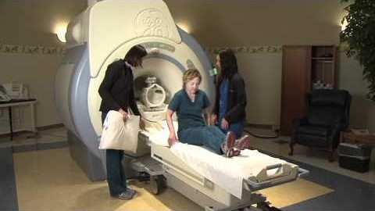
What happens during an MRI?

Slide 19
Breakout group activity, continued
As a breakout group, answer the following questions about medical MRI machines Have one member of your group write down your answers so you can copy-paste them later.
What problems might a medical MRI machine cause?
Who experiences those as problems?
According to you, why did the designers choose to design a machine that causes those problems?
How would you reduce or eliminate those problems?

Slide 20
They didn’t use Design Thinking
They focused on the technology, not the human beings
They designed for the doctors, not for the patients
Their solution made doctors’ lives better (and the doctors could treat patients better), but they made patients’ lives worse

Slide 21
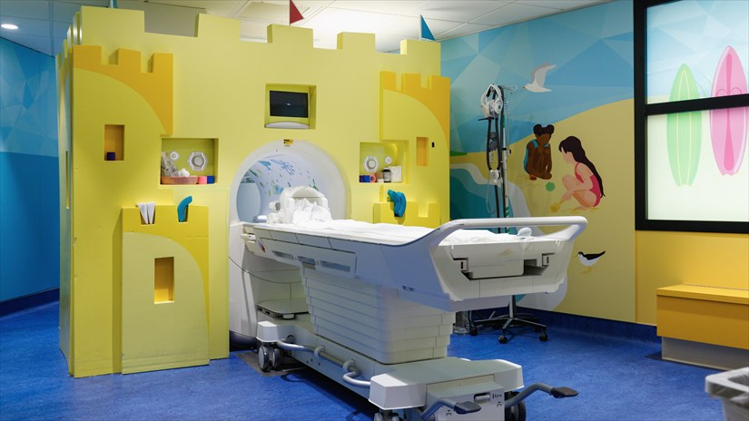
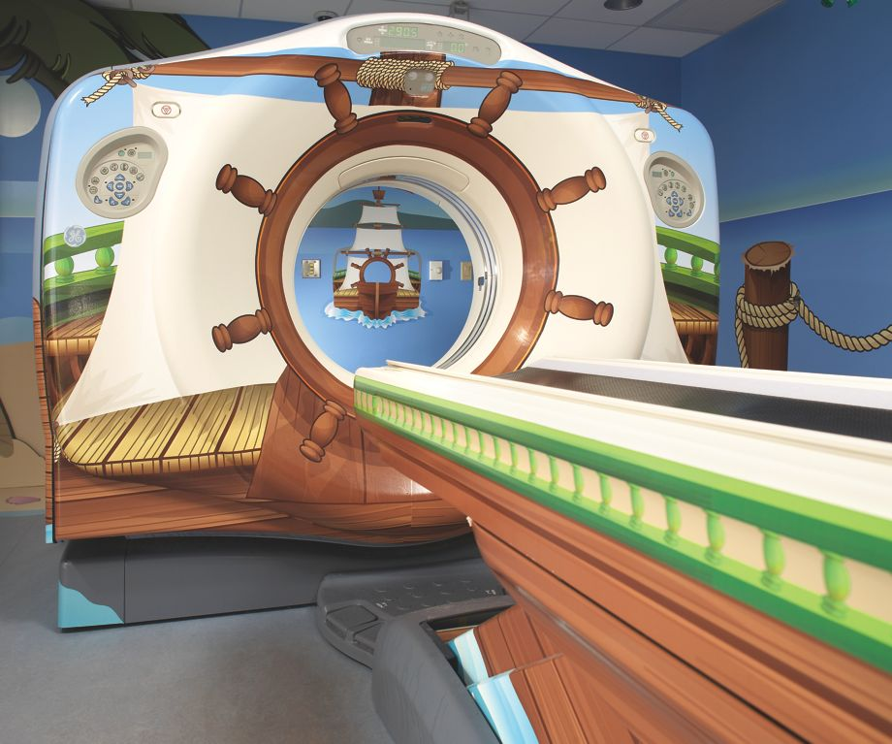
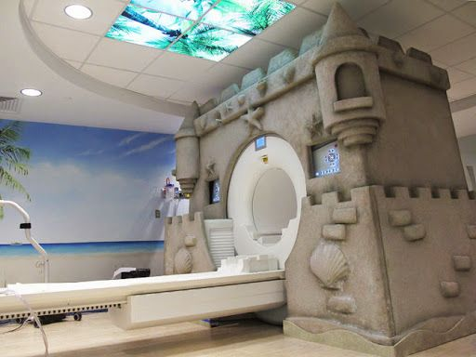
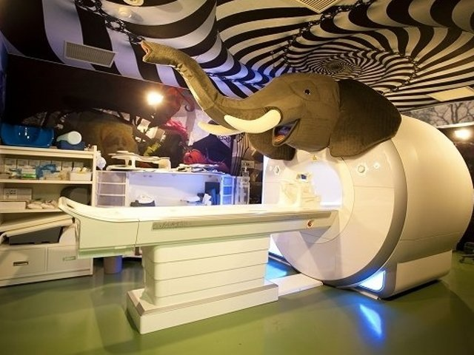
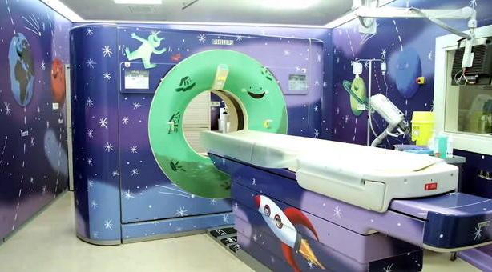
The Design Thinking solution: kid-friendly MRI machines

Slide 22
Advantages of Design Thinking
It produces solutions that create value for customers
It produces solutions that customers are more likely to buy
It produces solutions that increase corporate profits

Slide 23
Recapitulation

Slide 24
What was your big take-away from this session?
Type your answer in chat

Slide 25
What do you remember?
What is the definition of Design Thinking?
What are the advantages of Design Thinking?

Slide 26
Things You Must Know
The Definition of Design Thinking
The importance of human-centricity
The value of empathy and creativity
The positive effects of making people’s lives better
The Advantages of Design Thinking
It produces solutions that are more acceptable to customers
It produces solutions that customers are more likely to purchase and use
Companies that use Design Thinking make more money

